Slide 1
Prachi Agarwal
CSE 2nd year undergraduate student , IGDTUW
email:agarwalprachi2901@gmail.com

Slide 2
About me
Using technologies to solve challenges excites me and learning about newer technologies and innovations that are at the core of the force driving these solutions , is something that I yearn for.
At my university, I am part of various technical and non-technical societies like Enactus IGDTUW, which is a non-profit organisation, where I am a volunteer and Head for Research and Media team ,and I am also member of LeanIn, DSC and ACM Student chapters.
Currently I am doing my summer internship at ACM IGDTUW chapter where I am learning about the various computational techniques in ML and Data Science, and currently working on a project : Driver Drowsiness Detection , so as to use AI for social good.
You can find me reading a tech blog, a book, or painting in my past time.

Slide 3
Ekatra Video Chat Application

Slide 4
AGILE Methodology
As the challenge demanded us to apply Agile development while making the project, I set out to specify my goals for the project development.
As we know that Agile methodology is a way to manage a project by breaking it up into several phases. Once the work begins, a cycle through a process of planning, executing, and evaluating is also started.
I too started with the design of the basic structure of how my website will look , and searched and took ideas from various sources online. I also researched and read blogs, as well as youtube tutorials about the various libraries and APIs I could employ to add the peer to peer connection functionality.Acting upon the guidance of my mentor, I also learnt HTML,CSS and Javascript ,and React which helped me make frontend interface and the other functionalities.
After the one week of learning and designing period , I switched over to make the frontend of my website , as being a beginner , my mentor suggested I start with this. It took me 4 days to get the frontend of my website ready. After that I switched to the backend that involved making use of socket.io and webrtc connections. These two weeks I researched and worked extensively on adding the video calling, frontend , and screen sharing functionality.
In the adapt phase , I tried to attach the chat functionality and though not able to add before and after call chat feature , I was successful in adding in-call chat functionality feature.

Slide 5
AGILE Methodology: Sprints breakup
Building frontend and video and audio calling functionality, with screen sharing, and making UI better
Adapting Chat Functionality,
hosting on heroku and Netlify
Submission
Research , Design,Learning
New languages and technologies, APIs and frameworks like WebRTC,Socket.io,Peerjs, and HTML,CSS,JS

Slide 6
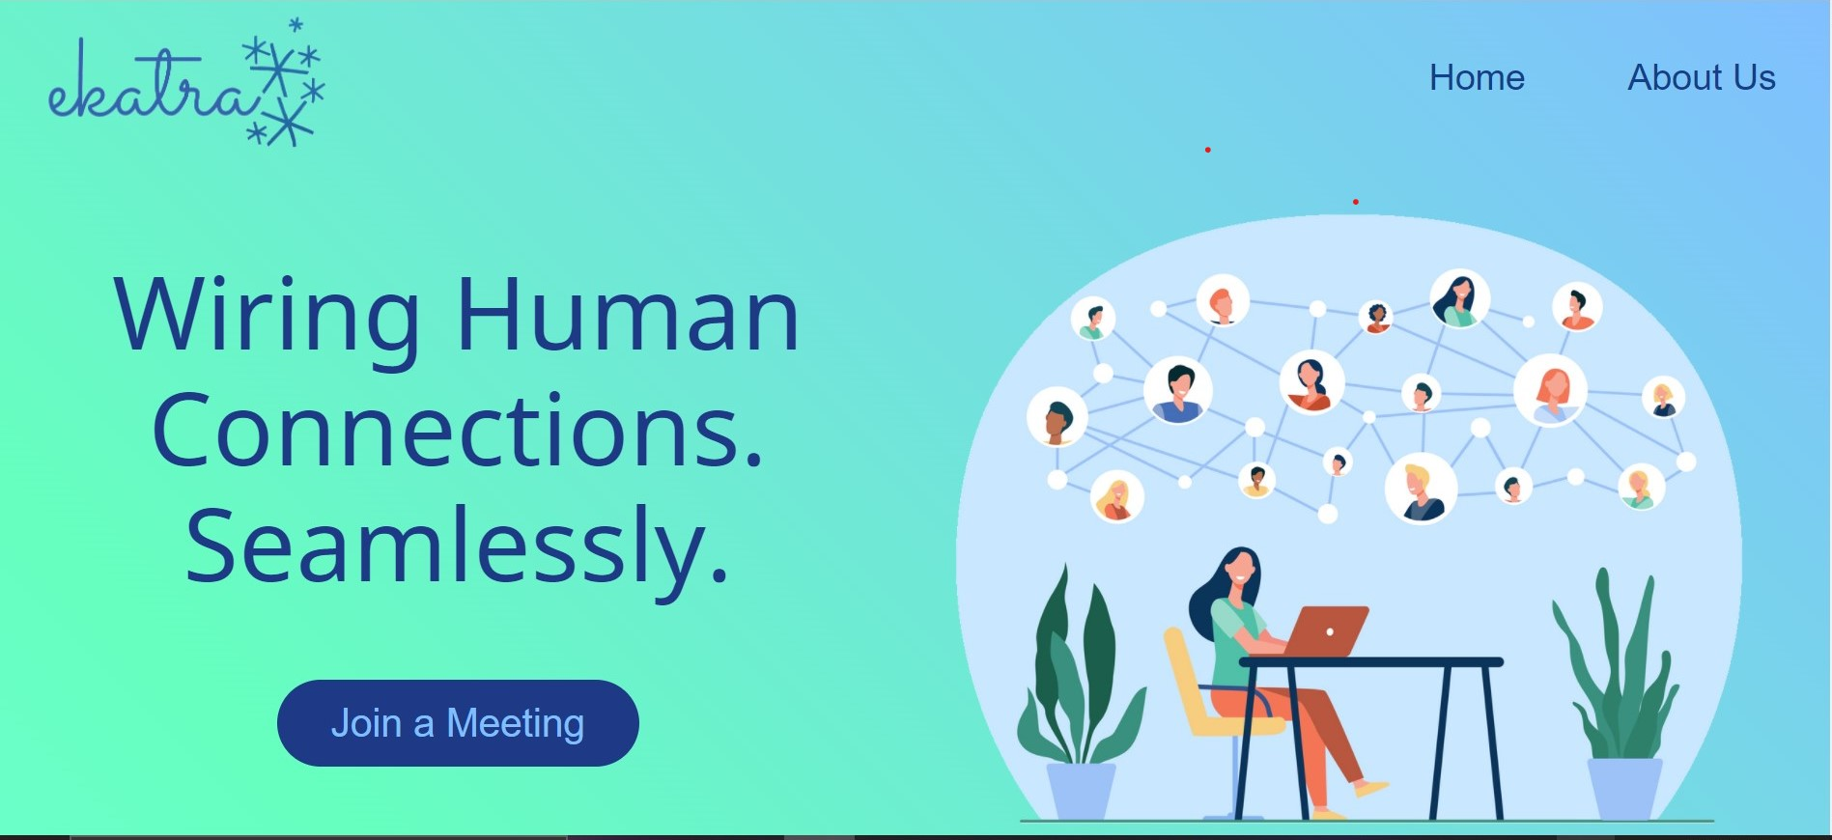
Ekatra | Wiring human Connections Video Chat Application
Ekatra is a video chat applications that offers video and audio interface functionality, made using WebRTC, and Socket.io.
Ekatra Offers Screen sharing as weel as chat messaging functionality to ensure a smooth and seamless remote communication expereince

Slide 7
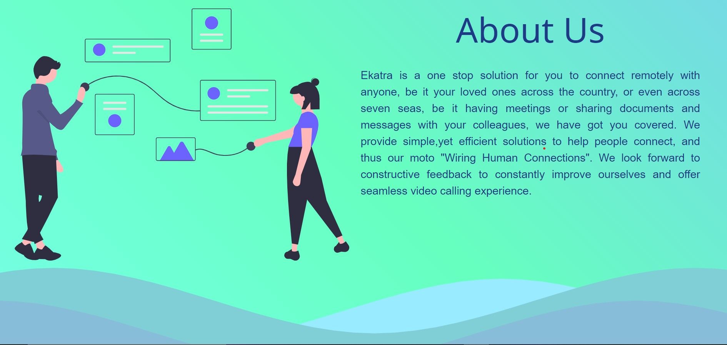
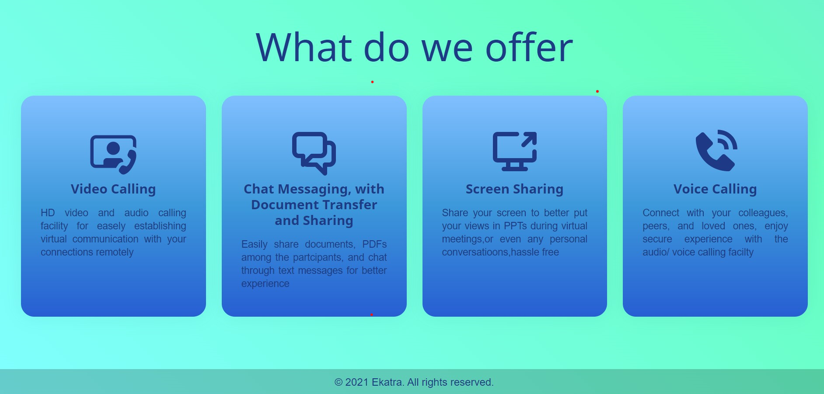
About Us Frame
Features Frame

Slide 8

Application Demo

Slide 9
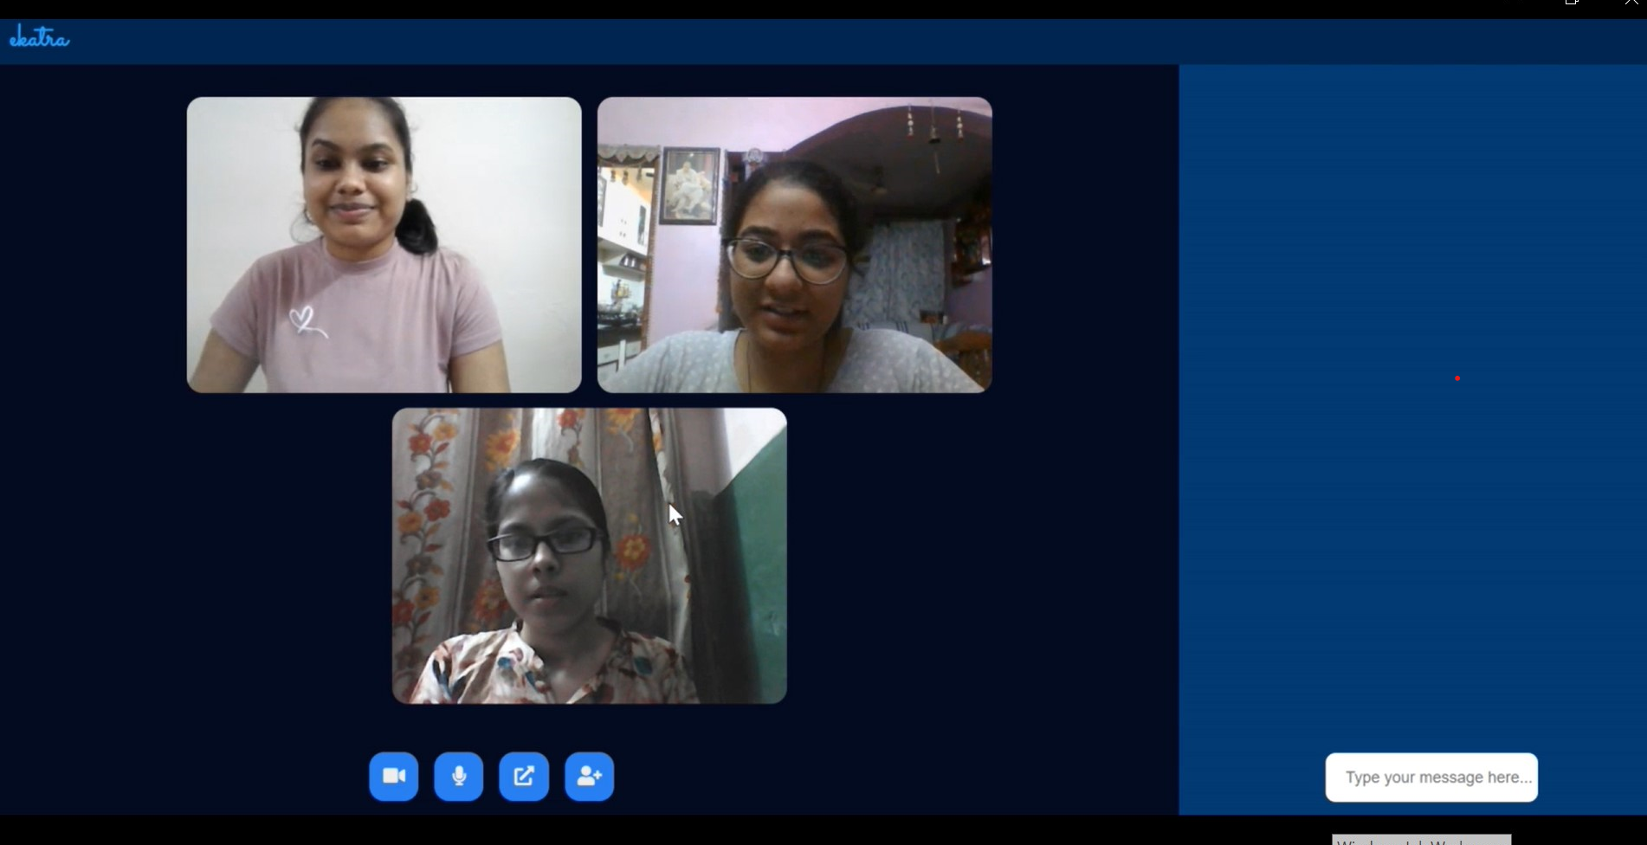
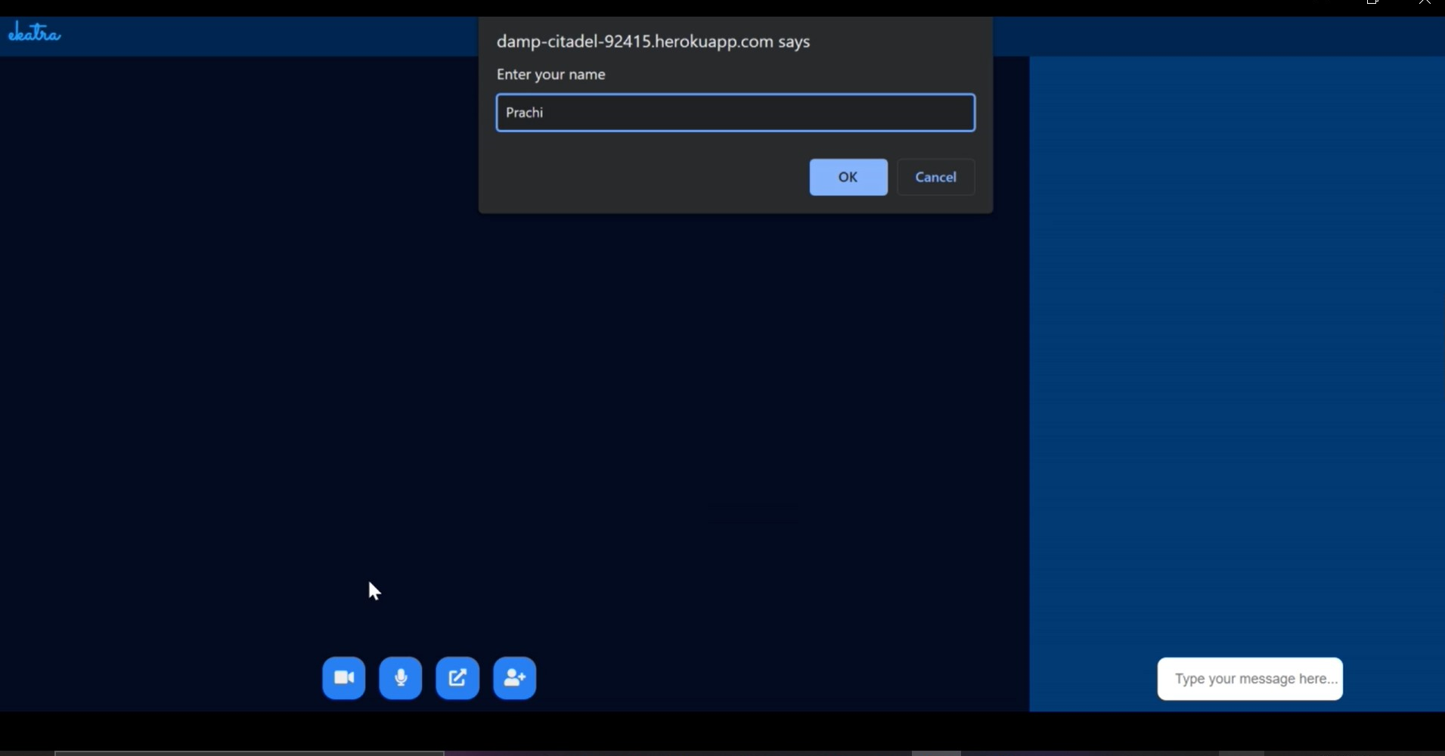
Some screenshots in between the working of Application

Slide 10
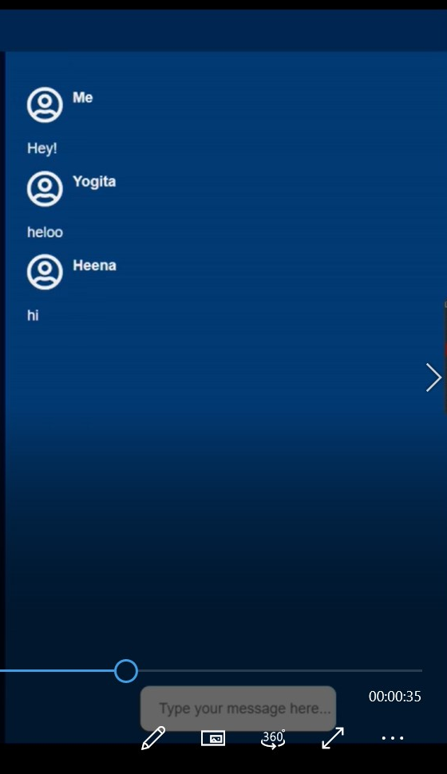
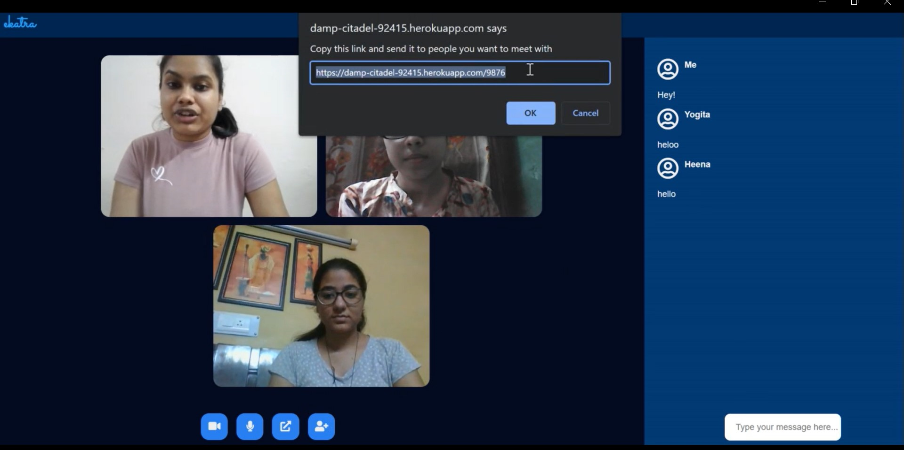
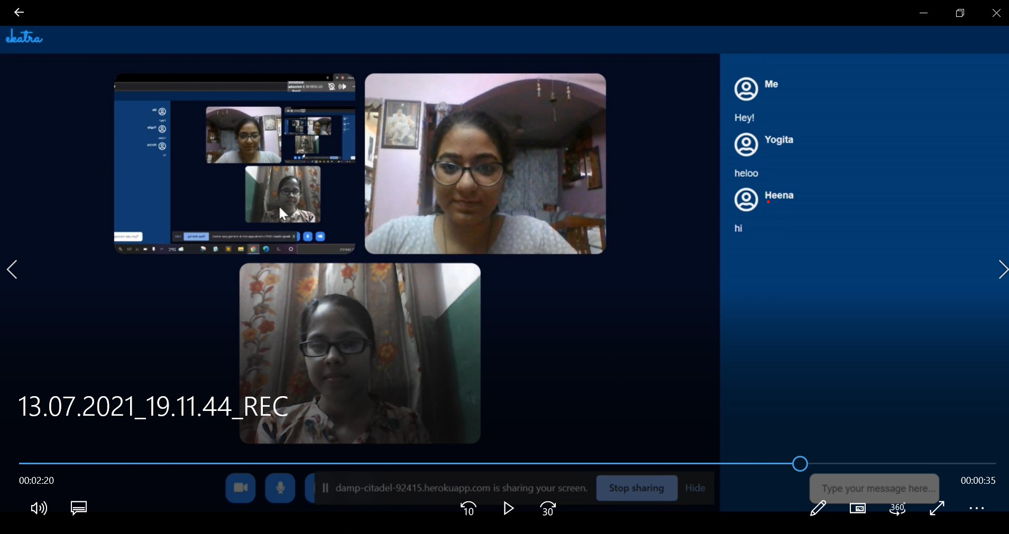

Slide 11
Thank you!
I would like to extend my gratitude to Microsoft and AceHacker team , for providing me with this opportunity that challenged me to the core. It proved to be a great learning experience for me as I got the to learn something new and from scratch . I would also like to thank my mentor whose guidance was very helpful and helped me grow and in my learning process. I also had a great time connecting with my fellow mentees and got a chance to build new connections.
The session by Microsoft and AceHacker team for teaching us about AGILE and the tests that were scheduled to help us measure our learnings also proved to be very fruitful.
Thankyou for this amazing opportunity!

